Slide 1
INTRODUCTION
LECTURE:1-4

Slide 2
DATA STRUCTURE
Data structure is a logical or mathematical model of a particular arrangement or organization of data.
In other words ,a data structure is a particular way of storing data in computer’s memory so that it can be used easily and efficiently.

Slide 3
A well designed data structure has the following characteristics:
i)It should be simple enough so that various operations(searching , insertion ,sorting etc.) can be performed on data effectively.
ii)It must be rich enough to mirror the actual relationship of data in real world.

Slide 4
Types Of Data Structures
Data structures are broadly divided into two categories:
Linear Data Structures
Non- Linear Data Structures

Slide 5
Linear Data Structures
A data structure is said to be linear if elements are adjacent to each other. It has exactly two neighbors elements to which it is connected as it’s previous and next member.
The various types of linear data structure are:
Array
Link List
Stacks
Queues

Slide 6
Non- Linear Data Structures
A data structure is said to be non linear data structure if one element can be connected to more than two adjacent elements.
The various types of non- linear data structures are:
Trees
Graphs

Slide 7
Other Classification of Data Structures
Homogeneous: Here all the values stored are of same type e.g. arrays
Non- Homogeneous: Here all the values stored are of different type e.g. structures and classes.
Dynamic:A dynamic data structure is one that can grow or shrink as needed to contain the data you want stored. That is, you can allocate new storage when it's needed and discard that storage when you're done with it. E.g. pointers, or references
Static:They're essentially fixed-size and often use much space E.g. Array

Slide 8
Data Structure Operations
The data appearing in the data structure is processed by means of certain operations:
Traversing
Searching
Inserting
Deleting
The below operations can be used in special situations:
Sorting
Merging
Copying
Concatenation

Slide 9
TYPES OF DATA STRUCTURES

Slide 10
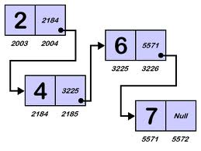
Linked List
A link list or one way list is a linear collection of data elements called nodes, where the linear order is given by means of pointers. Each node is divided into two parts:
Contains the information of the element
Contains the address of the next node in the list.

Slide 11
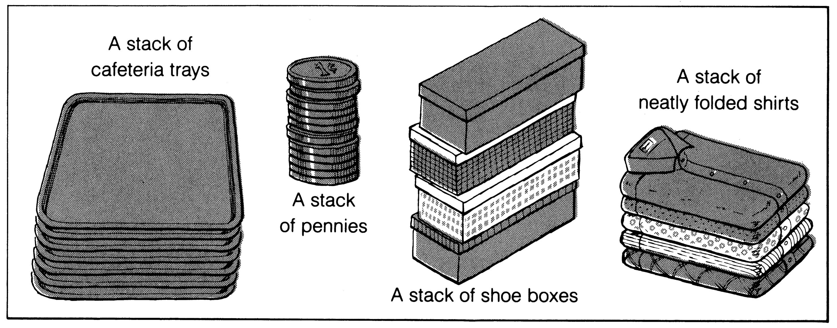
STACK
It is an ordered group of homogeneous items of elements.
Elements are added to and removed from the top of the stack (the most recently added items are at the top of the stack).
The last element to be added is the first to be removed (LIFO: Last In, First Out).

Slide 12
QUEUES
Queue is an ADT data structure similar to stack, except that the first item to be inserted is the first one to be removed.
This mechanism is called First-In-First-Out (FIFO).
Placing an item in a queue is called “insertion or enqueue”, which is done at the end of the queue called “rear”.
Removing an item from a queue is called “deletion or dequeue”, which is done at the other end of the queue called “front”.

Slide 13
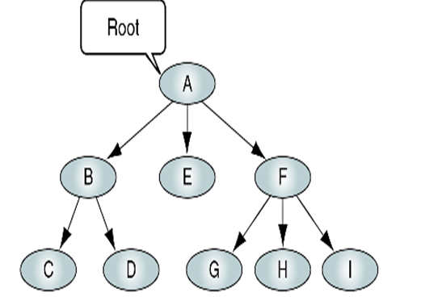
TRESS
A tree consists of finite set of elements, called nodes, and a finite set of directed lines called branches, that connect the nodes.
The number of branches associated with a node is the degree of the node.

Slide 14
GRAPH
A graph is a finite set of nodes with edges between nodes
Formally, a graph G is a structure (V,E) consisting of
  a finite set V called the set of nodes, and
  a set E that is a subset of VxV. That is, E is a set of pairs of the form (x,y) where x and y are nodes in V .

Slide 15
ALGORITHM

Slide 16
ALGORITHMS
An algorithm is a sequence of steps or instructions required to solve a given problem.
Once these steps described in an algorithm are performed on data specified ,the expected result is obtained.
Every algorithm must possess the following properties:

Slide 17
Finiteness:The number of steps involved in an algorithm to solve a problem must be finite.
Definiteness: the steps involved in a given algorithm must be precise, clear and unambiguous.
Simplicity: the steps involved in a given algorithm must be simple enough so that output can be computed easily by paper and pencil
Input: to solve any problem ,the algorithm must receive some input.

Slide 18
Output: the algorithm must produce atleast one output
Correctness : the algorithm must produce at least one output which is the solution to the given problem.
Generality: the procedure inherited in specific algorithm should be applicable to all algorithms of same general form with minor modification permitted.

Slide 19
ALGORITHM COMPLEXITY
It is very rare to have a single algorithm for solving a problem ,often in a given problem different algorithm having different efficiencies can be used.
Measuring an algorithm’s efficiency is important because choice of an algorithm for a given application often has a great impact.
Eg:life support systems,flight reservation system and video games all depnds on efficient algorithms.

Slide 20


Slide 21
To measure the efficiency of an algorithm ,we need to analyze the algorithm.
The study of algorithm is necessary to determine the amount of time and storage space an algorithm may require for execution.
This analysis of an algorithm in terms of time and space for processing input data is known as algorithms complexity.

Slide 22
Definition:
The complexity of an algorithm is a function f(n) that gives the running time and memory space required by an algorithm for processing the input data of size n.

Slide 23
The complexity of an algorithm M is the function f(n) which gives the running time and/or storage space requirement of the algorithm in terms of the size n of the input data.
Two types of complexity
1. Time Complexity
2. Space Complexity
Complexity of Bubble Sort Algorithm:
The time required to execute the bubble sort algorithm is proportional to n².
F(n)= (n-1)+(n-2)+…………….+2+1=n(n-1)/2=n²/2+O(n)=O(n²)

Slide 24
SPACE COMPLEXITY
Space Complexity is the amount of memory required to execute an algorithm.
It is expressed as a function f(n) that describes the amount of memory an algorithm takes for processing n input data elements.
The space required by the algorithm when implemented not only includes the instruction space(set of instructions comprising the algorithm when executed) but also includes data space(amount of data elements the algorithm process).
Space Complexity is important but inexpensive memory has reduced the significance ,thus main area of concern is time complexity

Slide 25
TIME COMPLEXITY
Time Complexity is the amount of time required to execute an algorithm.
The time complexity of the algorithm is a function f(n) that describes the efficiency of an algorithm in terms of size n of the input data.
As time complexity is dependent on the key operations rather than all operations so we usually express complexity f(n) as proportationai input size n of the input data.

Slide 26
TIME SPACE TRADE OFF
The best algorithm used to solve a problem is the one that requires less time and less space when implemented.
But in real life its not possible.So one aspect of algorithm has to be compromised at the cost of other.
Thus there exists a time space tradeoff among algorithms

Slide 27
Its says while solving a problem where time is critical, we choose an algorithm that requires less time to complete when implemented at the cost of more memory.
On other hand if space is critical while solving a problem then we choose an algorithm that consumes less space when implemented in memory at the cost of more time

Slide 28
There are three cases generally for which the efficiency of the algorithm needs to be determined for given input n.these three cases are:
Worst Case:It is the longest (worst) running time of an algorithm for all inputs of given size i.e. the maximum number of steps taken for all possible of size n.
Best Case:It is the shortest (best) running time of an algorithm for all inputs of given size i.e. the minimum number of steps taken for all possible inputs of size n.
Average Case:It is the average running time for all inputs of a given size i.e. how long on average does the algorithm takes to run.The avg.case always falls between best and worst case.

Slide 29
COMPLEXITY

Slide 30
CALCULATION OF TIME COMPLEXITY
AVERAGE OF NUMBER
void AVERAGE[int A[],int n)
{ int i;----(1)
Float avg,SUM=0;---(2)
For (i=1;i<=n;i++)-----(3,4)
SUM=SUM+A[I];---(5)
Avg= SUM/n;----(6)
Cout<<avg;----(7)
Return ;-----(8)
}
1,2,6,7,8---implemented once
3,4,5---implemented n times
3n+5
1.SUM←0
2.Repeat step 3 for I=1 to N.
3.SUM←SUM+A[I]
[End of step 2 loop]
4.AVG←SUM/N
5.Write AVG
6.Return

Slide 31
void AVERAGE[int A[],int n)
{ int i;----(1)
Float avg,SUM=0;---(2)
For (i=1;i<=n;i++)-----(3,4)
SUM=SUM+A[I];---(5)
Avg= SUM/n;----(6)
Cout<<avg;----(7)
Return ;-----(8)

Slide 32
Void{
For (i=1;i<=n;i++)----(1,2,3)
For(j=1;j<=n;j++)----(4,5,6)
C[i][j]=A[i][j]+B[i][j];---(7)
Return;----(8)
}

Slide 33
MATRIX ADDITION SUB-ALGO
MATRIXADD(A,B,C,M,N)
1.Repeat step 2 for I=1 to N
2.Repeat for J=1 to N
C[I][J]=A[I][J]+B[I][J]
[End of inner loop]
[end of outer loop]
3.Return.
Void{
For (i=1;i<=n;i++)----(1,2,3)
For(j=1;j<=n;j++)----(4,5,6)
C[i][j]=A[i][j]+B[i][j];---(7)
Return;----(8)
}
1,8----implemented once
2,3,4---implemented n times
5,6,7---exectued n times for both inner and outer loop so n^2 times
2+3n+3n^2

Slide 34
Asymptotic Complexity
The measure of time complexity of an algorithm where we disregard certain terms of a function to express the efficiency of an algorithm is called asymptotic complexity.

Slide 35
Big-O Notations
This notation has been developed as the standard for comparing algorithm.
The main aim of this notation is to identify the dominant term in the determining the time complexity of an algo.
Definition: Let f(n) and g(n) be the two functions where n is +ve integer, then we can say that f(n) is of the order g(n),generally written as: f(n)=O(g(n))
if and only if there exists a constant c>0 such that
|f(n)|<= c|g(n)|for n>=n₀, where n₀ is an arbitrary large +ve number.

Slide 36
Other Asymptotic Notations
Big Omega Notation(Ω): Big-O notation is used for ananlyzing upper bound of the function , the omega notation is used when the function defines a lower bound for the function f(n). It is formally defined as
f(n)=omega(g(n))
If and only if there exists a +ve constant c and n₀ such that f(n)>=c.g(n) for n>n_{0.} The definition is read as function f(n) is omega of g(n) if there exists a +ve number c such that f(n) is atleast equal to c.g(n) for almost all values of n where n>n₀

Slide 37
Big –Theta Notation(ᶱ)
f(n)=theta g(n)
Theta notation can be described as f(n)=theta g(n)if and only if there exits +ve constant c and n₀ such that f(n)=c.g(n) for all n>=n₀ . In other words, for large n, g(n) is tight bound for f(n) i.e. g(n) is both lower and upper bound for f(n).

Slide 38
Basic Efficiency Classes
Classes | Names
1 | Constant
Log n | Logarithmic
n | linear
N log n | n-log-n
n^2 | Quadratic
n^3 | Cubic
2^n | Exponential
n! | Factorial

Slide 39
Basic Notations
Algorithmic Notations:
Finite step by step list of well-defined instructions for solving a particular problem.
Formal presentation of the Algorithm consists of two parts:
A paragraph that tells the purpose of an algorithm. Identifies the variables which occur in the algorithm and lists the input data.
The list of the steps that is to be executed.
Some conventions used in Algorithms:
Identifying Number (Algorithm 2: )
Steps, Control and Exit ( All statements are numbered, Go to and Exit)
Comments (The comments are to be given to understand the meaning)
Variable Names (capital letters are used for variable names)
Assignment Statement (Max:=DATA[1])
Input and output (Read: variable names, Write: Messages and/or variable names)
Procedure

Slide 40
Basic Notations
Control Structures:
Sequential Logic or Sequential Flow
Selection Logic or Conditional Flow
    If (condition) Endif
    If (condition) Else Endif
    Multiple If Elseif Else Endif
Iteration Logic (Repetitive Flow)
Repeat for K=R to S by T:
[Module]
[End of Loop]

